Slide 1
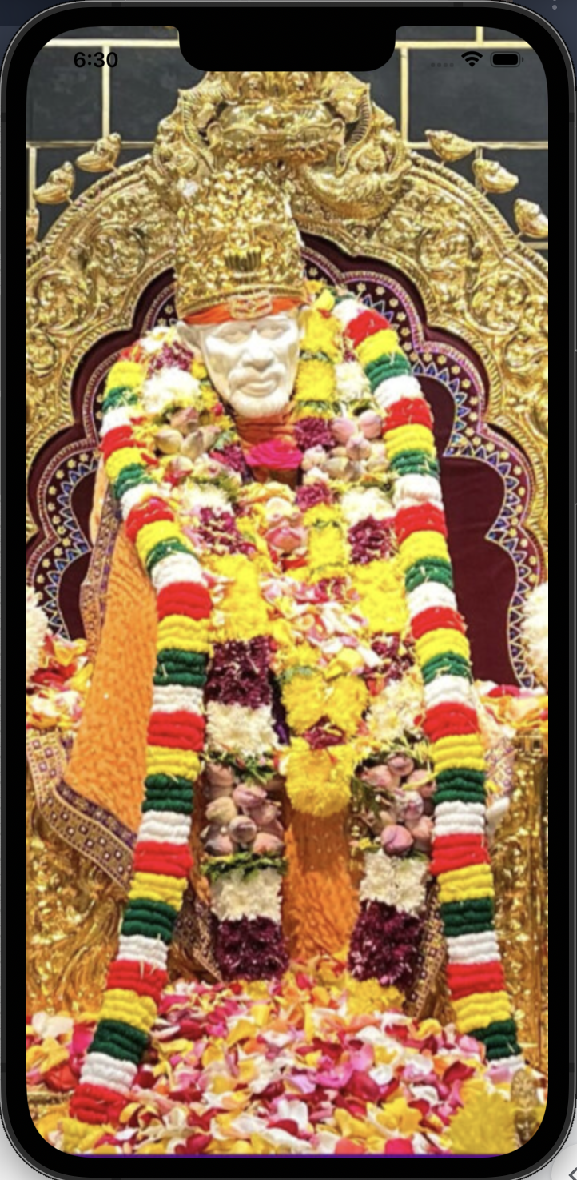
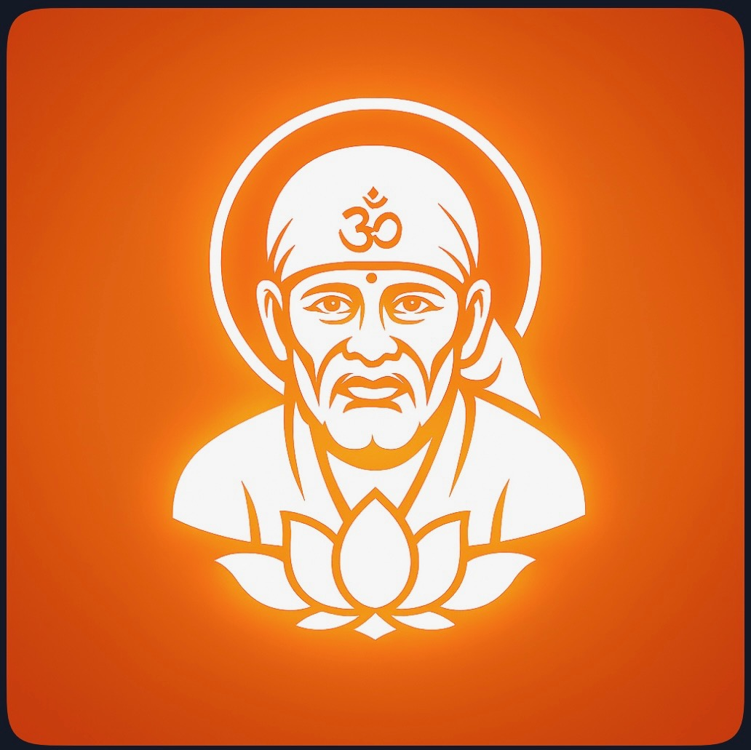
Sai Temple Mobile App

Slide 2

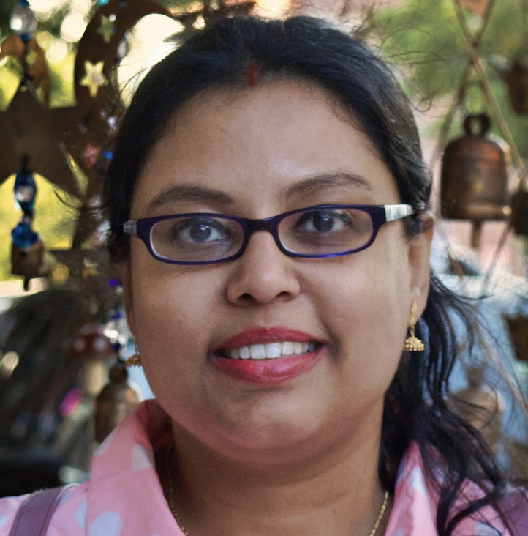

About us
Reetam Biswas
Architect/Design/Solution
Love tech and music
Sylvia Biswas
Idea/Analyst/Documentation
Love cooking and travel
Stotra Biswas
Initiator/learner
In 8th grade, love Crocheting, Bharatanatyam

Slide 3
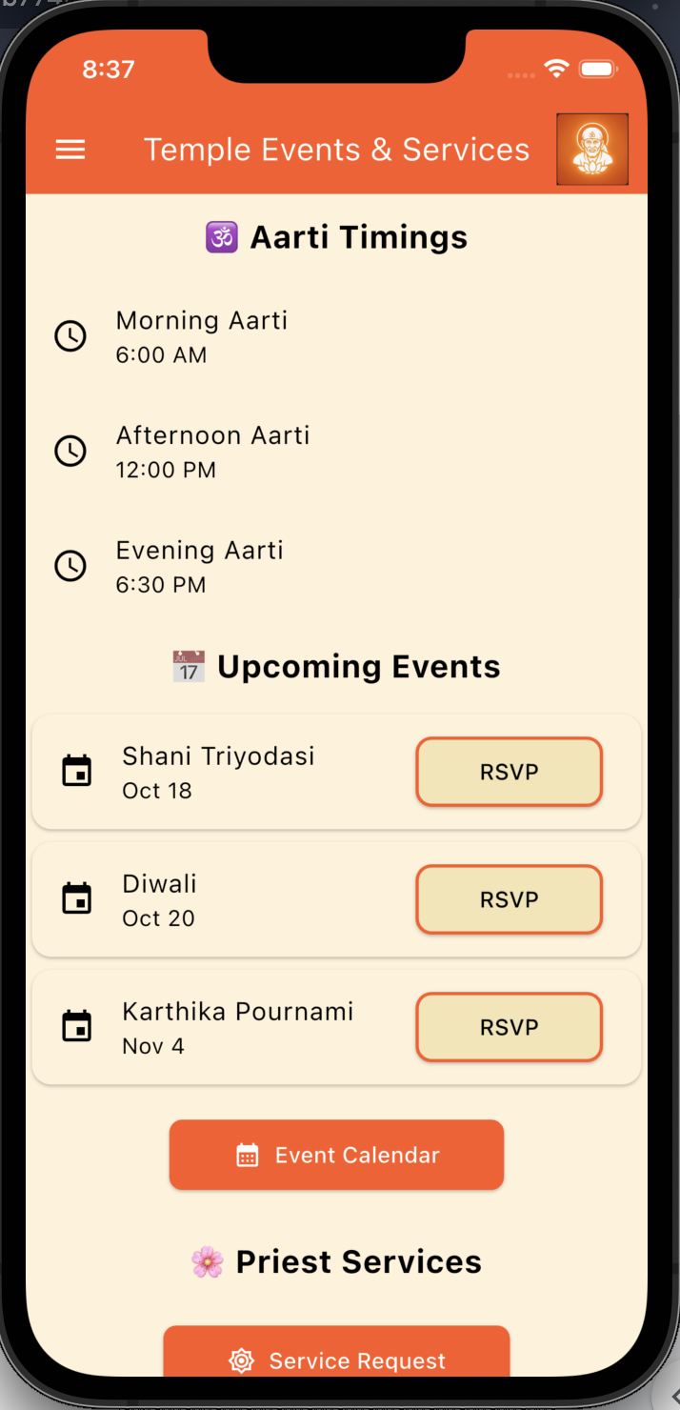
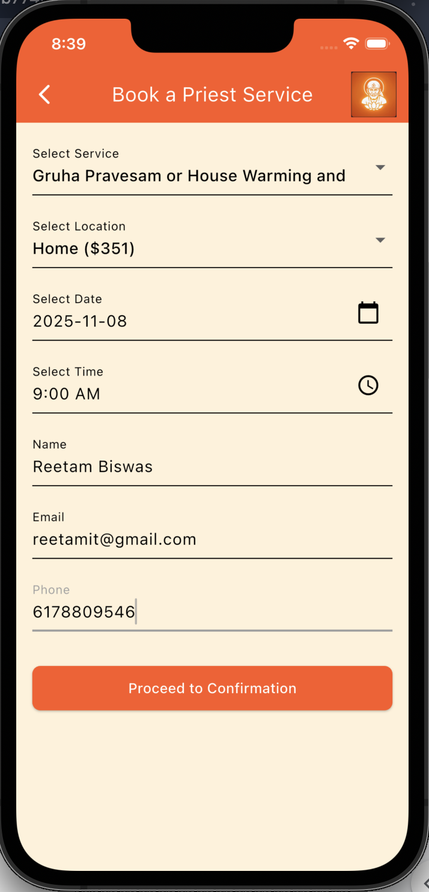
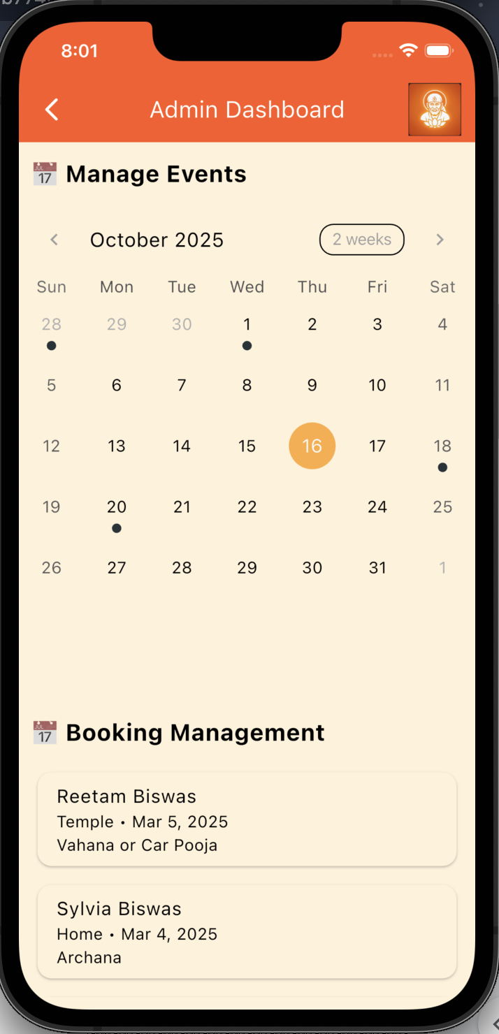
Concept & Layout

Slide 4
Benefit
🙏 For Devotees
Easy Event Access: View upcoming pujas, festivals, and spiritual talks with calendar integration and reminders.
Online Booking : Reserve slots for darshan, priest services, or temple halls without waiting in line.
Donation Convenience: Make secure donations or sponsor rituals directly through the app.
Volunteer Sign-Up: Join seva opportunities with role-based registration and shift tracking.
🧘 For Priests
Service Scheduling: Manage bookings for home visits, rituals, and ceremonies with availability toggles.
Profile Visibility: Display languages spoken, service types offered, and ratings to help devotees choose.
Notifications: Receive real-time alerts for new bookings or schedule changes.
🛕 For Temple Admins
Dashboard Analytics: Track user engagement, donations, event attendance, and volunteer hours.
Booking Management: Approve or reject service requests, assign priests, and monitor capacity.
Event Coordination: Create and edit events with time, location, and assigned staff.
Push Notifications: Send updates about special events, closures, or spiritual messages.
Community Insights: Export reports for temple committees and plan outreach more effectively.

Slide 5
Questions ?

